Slide 1

Ex 4-Scoring
BY TEAM 3

Slide 2
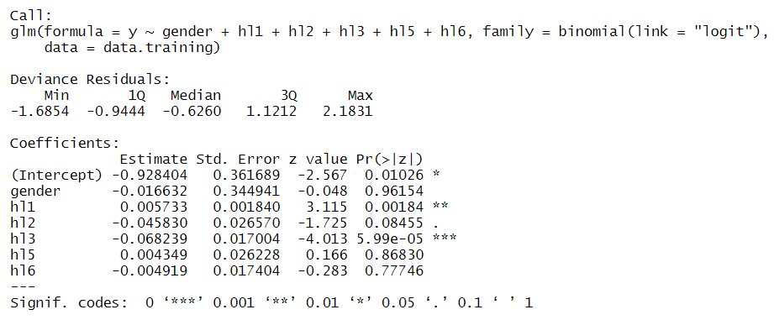
Q1 – Logit model
Model summary (including all coefficients and p-values)
Three variables are significant: hl1, hl2 and hl3

Slide 3
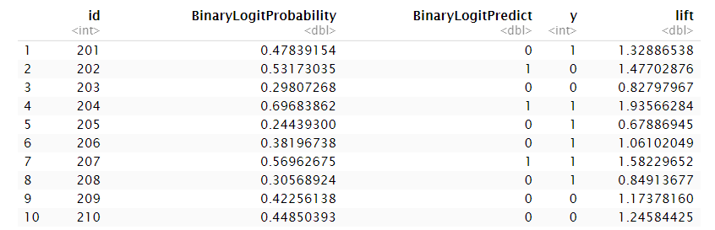
Q2 – Testing model
Prediction summary for the first 10 names
Predicted response rate
Predicted lift

Slide 4
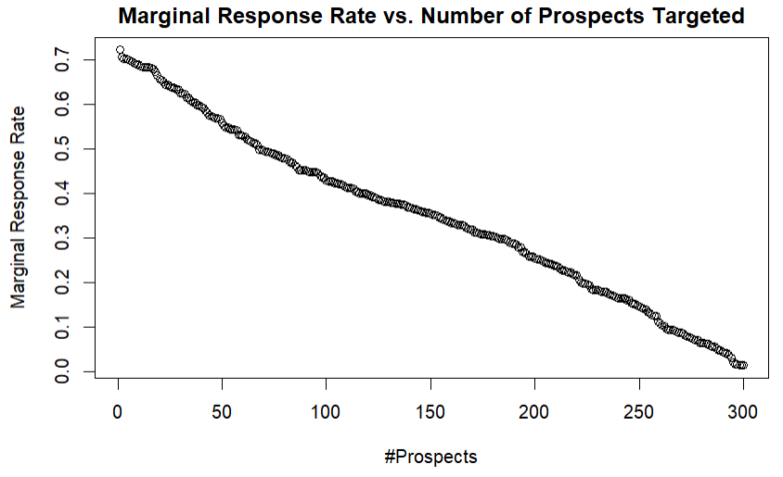
Q4 – Plot Marginal Response Rate vs. Number of Prospects Targeted
Chart

Slide 5
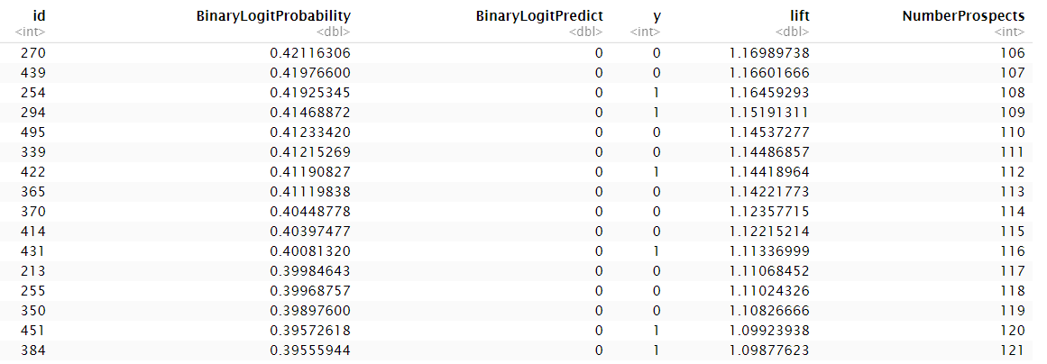
Q5 – Who CD club should target based on Marginal Cost Rule
Cut-Off Response Rate and Results
Based on Marginal Cost Rule, we choose the highest value of n such that the nth highest predicted response rate p_{n} > solicitation cost / E(CLV) which is equal to 12/30 or 0.4
Therefore, the Cut-off Response Rate should be 0.4. This corresponds to n = 116.
The club should send invitations to 116 prospects with the highest predicted response rate
Complete list of Target IDs of all 116 prospects in Appendix

Slide 6
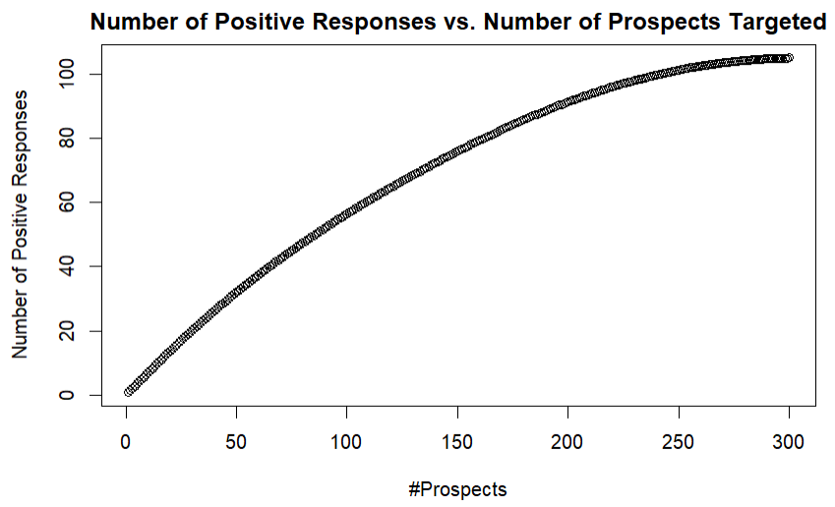
Q6 – Plot Number of Positive Responses vs. Number of Prospects Targeted
Chart

Slide 7
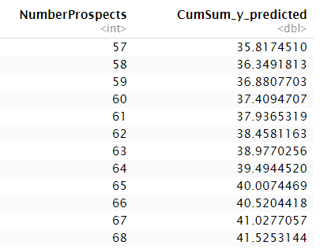
Q7 – Who CD club should target based on Limited Supply Rule
Results
Based on the Limited Supply Rule, we choose n such that the sum of n highest predicted response rate, SUM_p(y=1), is just under the maximum number of items k
With k = 40, we find that SUM_p(y=1) is 39.494 for n=64 and 40.007 for n=65
Therefore, the club should send invitations to the 64 prospects with the highest predicted response rate
Complete list of Target IDs of all 40 prospects in Appendix

Slide 8
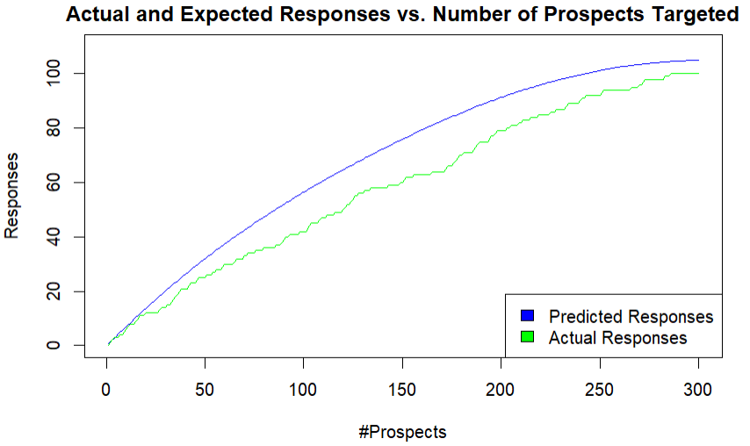
Q8 – Actual vs predicted responses
Chart and comments
The Actual Response Rates are consistently lower than Predicted Response Rates in the Testing Sample
The current model seems to have overpredicted positive responses
Impact on Step 7: Because of overprediction, in order to achieve 40 responses, the club should send out more than 64 invitations
Over Predicting

Slide 9
Appendix

Slide 10
Target IDs
116 prospects targeted in Q5 (Marginal Cost Rule)
331, 392, 220, 360, 301, 485, 204, 491, 498, 332, 342, 243, 444, 309, 446, 401, 219, 320, 438, 400, 269, 455, 251, 258, 300, 313, 456, 343, 215, 356, 443, 275, 493, 227, 241, 357, 462, 217, 225, 338, 268, 482, 264, 417, 337, 379, 207, 441, 273, 257, 376, 494, 330, 293, 327, 415, 500, 202, 380, 366, 324, 329, 325, 230, 428, 463, 233, 214, 292, 261, 354, 397, 222, 351, 224, 460, 290, 419, 289, 201, 394, 256, 458, 427, 277, 344, 420, 368, 450, 212, 488, 299, 478, 210, 470, 403, 474, 461, 359, 459, 311, 483, 391, 288, 209, 270, 439, 254, 294, 495, 339, 422, 365, 370, 414, 431
64 prospects targeted in Q7 (Limited Supply Rule)
331, 392, 220, 360, 301, 485, 204, 491, 498, 332, 342, 243, 444, 309, 446, 401, 219, 320, 438, 400, 269, 455, 251, 258, 300, 313, 456, 343, 215, 356, 443, 275, 493, 227, 241, 357, 462, 217, 225, 338, 268, 482, 264, 417, 337, 379, 207, 441, 273, 257, 376, 494, 330, 293, 327, 415, 500, 202, 380, 366, 324, 329, 325, 230

